Slide 1
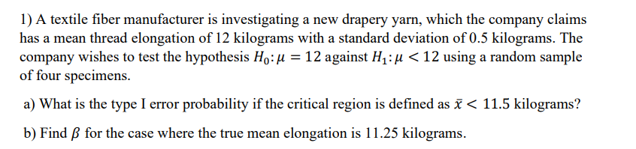
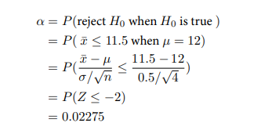
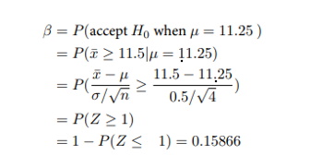

Slide 2
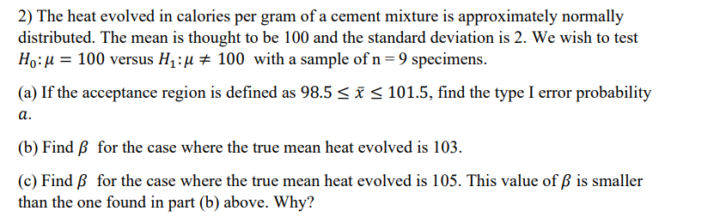
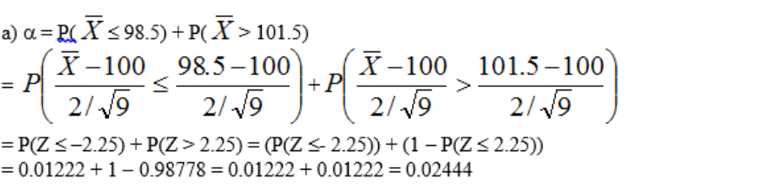

Slide 3
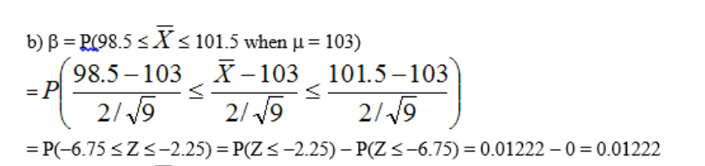

Slide 4
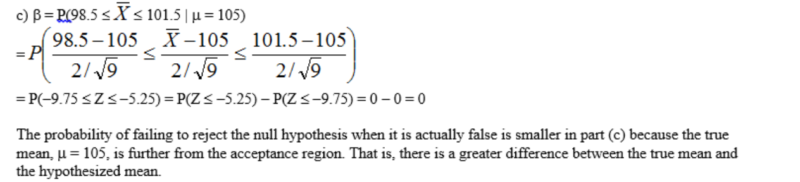

Slide 5
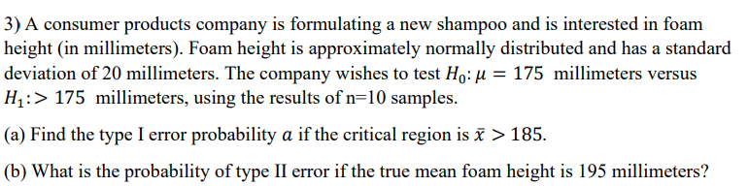
0.05705
b) 0.05705

Slide 6
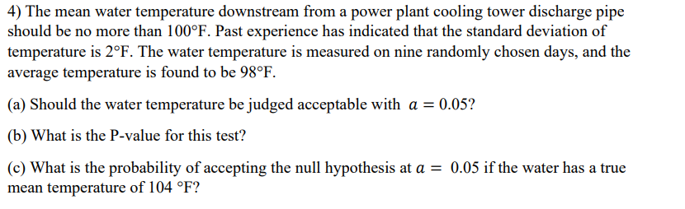
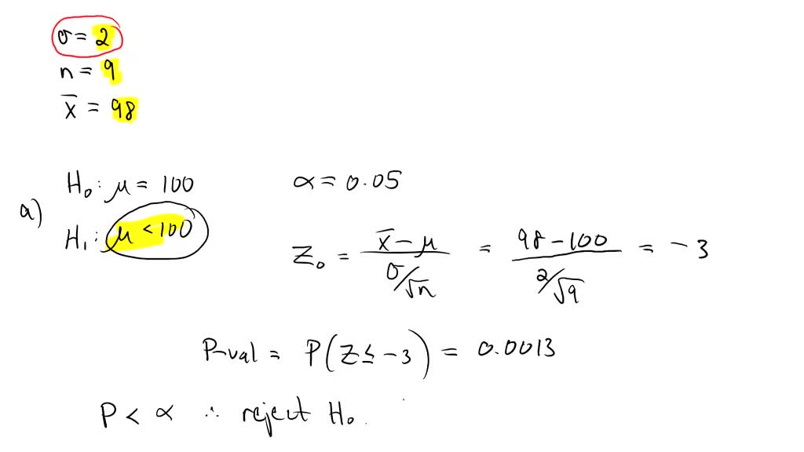

Slide 7

$$μ_{±}z_{a} ∗ \frac{σ}{\sqrt{n}}$$
100 $−$ 1.645 * 2 / 3 = (98.91)
P(98.91 – 104 / (2/3) $≥$ $μ$
P (Z$≥$(-7.6)) = 1

Slide 8
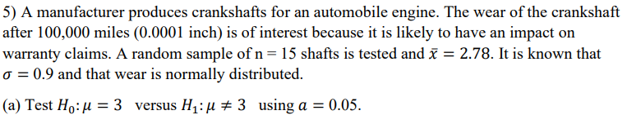
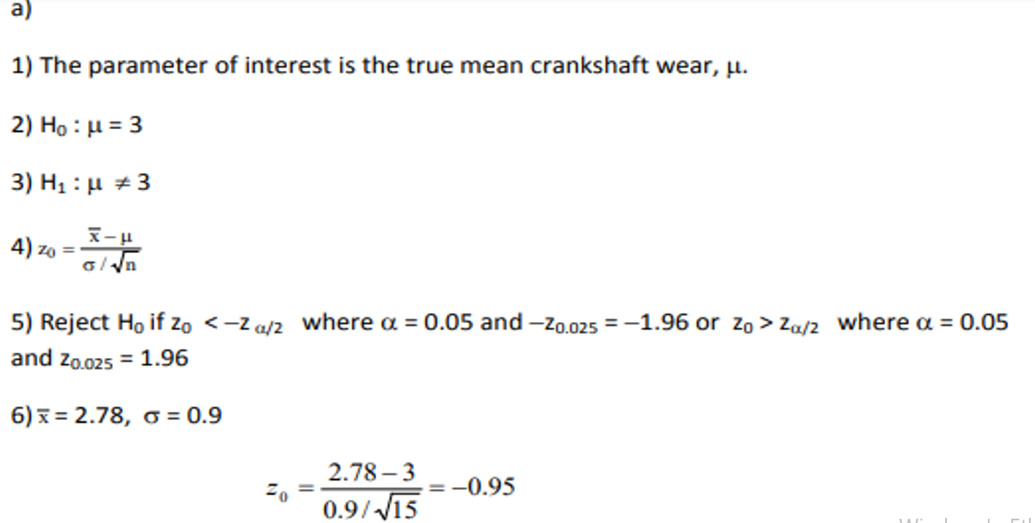
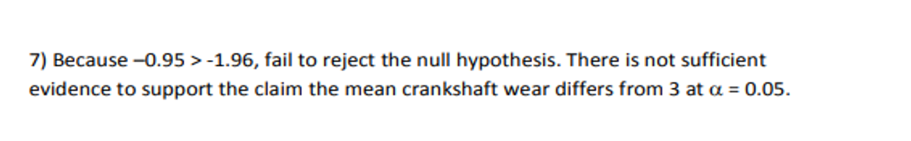

Slide 9
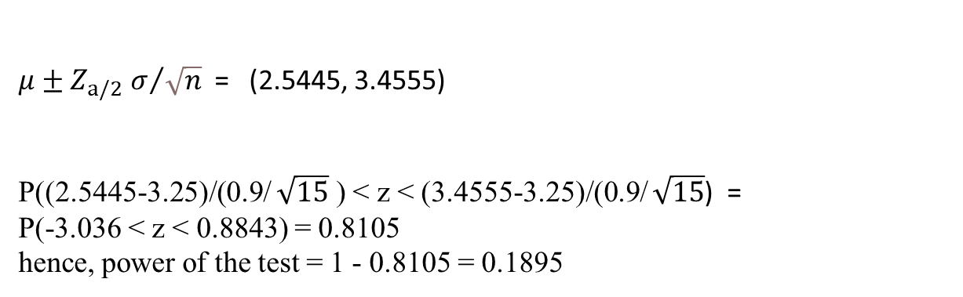
$μ±Z_{a/2}$ $σ/{\sqrt{n}}$ = (2.5445, 3.4555)
P((2.5445-3.25)/(0.9/ $\sqrt{15}$ ) < z < (3.4555-3.25)/(0.9/ $\sqrt{15}$) =
P(-3.036 < z < 0.8843) = 0.8105
hence, power of the test = 1 - 0.8105 = 0.1895

Slide 10
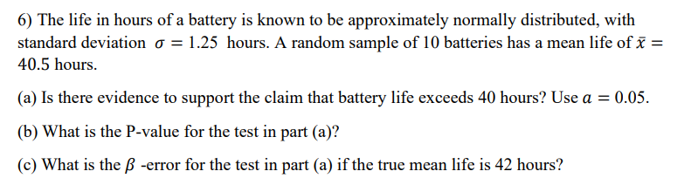
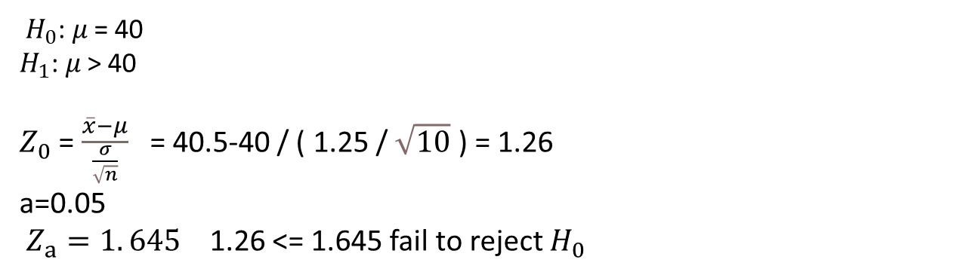
${ H}_{0}$: 𝜇 = 40
$H_{1}$: 𝜇 > 40
$Z_{0}$ = $\frac{\overline{x}−μ}{\frac{σ}{\sqrt{n}}}$ = 40.5-40 / ( 1.25 / $\sqrt{10}$ ) = 1.26
a=0.05
$Z_{a}=1. 645$ 1.26 <= 1.645 fail to reject $H_{0}$
b) 1- Z (x < 1.26) = 0.1038

Slide 11
C) Z (x<= -3.42) = 0.0003

Slide 12
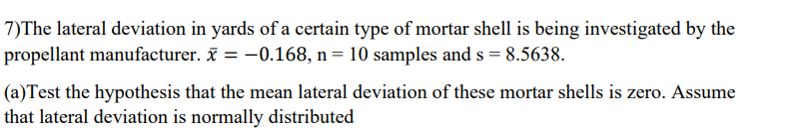
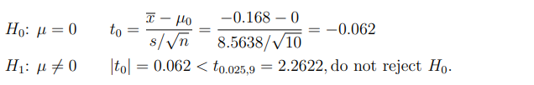

Slide 13
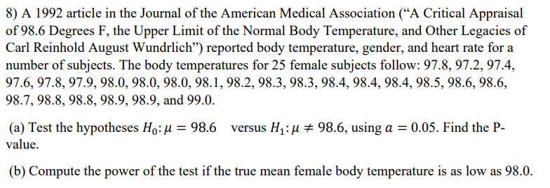
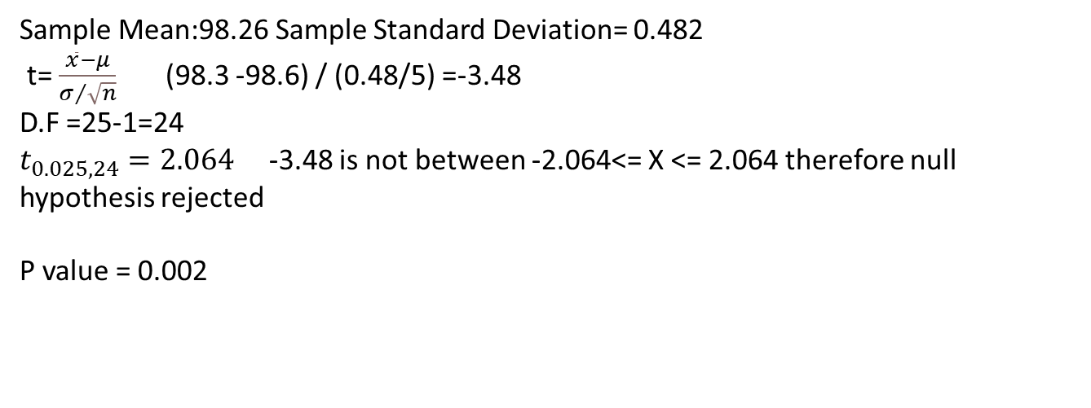
Sample Mean:98.26 Sample Standard Deviation= 0.482
t= $\frac{\overline{x}−μ}{σ/{\sqrt{n}}}$ (98.3 -98.6) / (0.48/5) =-3.48
D.F =25-1=24
$t_{0.025,24}=2.064$ -3.48 is not between -2.064<= X <= 2.064 therefore null hypothesis rejected
P value = 0.002

Slide 14
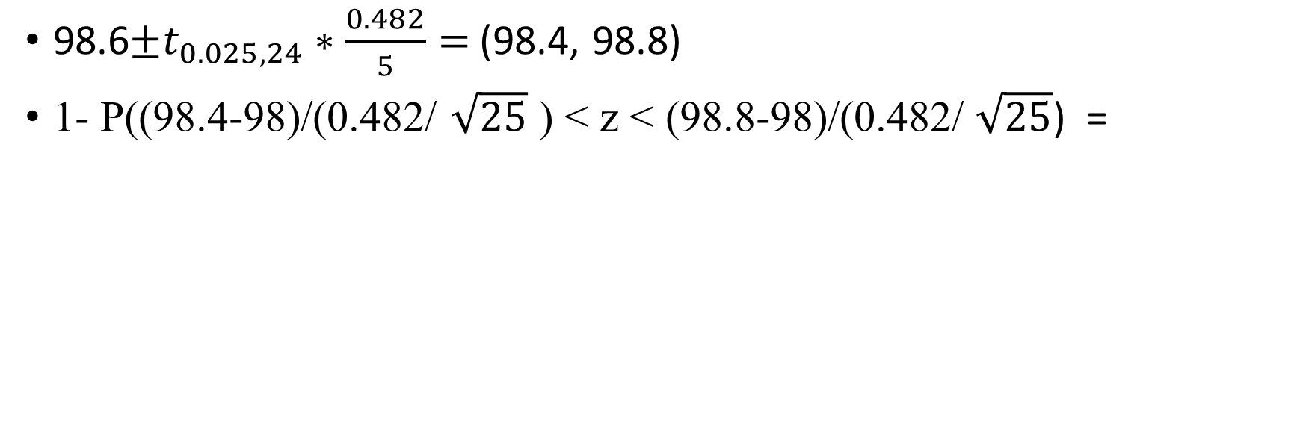
98.6$±t_{0.025,24}∗\frac{0.482}{5}=$(98.4, 98.8)
1- P((98.4-98)/(0.482/ $\sqrt{25}$ ) < z < (98.8-98)/(0.482/ $\sqrt{25}$) =

